Slide 1
Parallel Sorting
CS121 Parallel Computing
Spring 2020

Slide 2
Outline
Radix sort
Merge sort
Bitonic sort
Sample sort

Slide 3
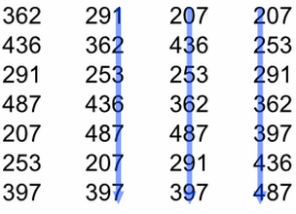
Radix sort
Sort digit by digit, going from the least to most significant digit.
Sort must be stable. If there’s tie on current digit, must preserve order from previous digits.
Ex When sorting 100s digit, there’s a tie on value 3. Preserve earlier order, i.e. 362 before 397.
Sorting each digit (or group of digits) highly parallel.
Radix sort is typically one of the fastest sorts in practice.

Slide 4
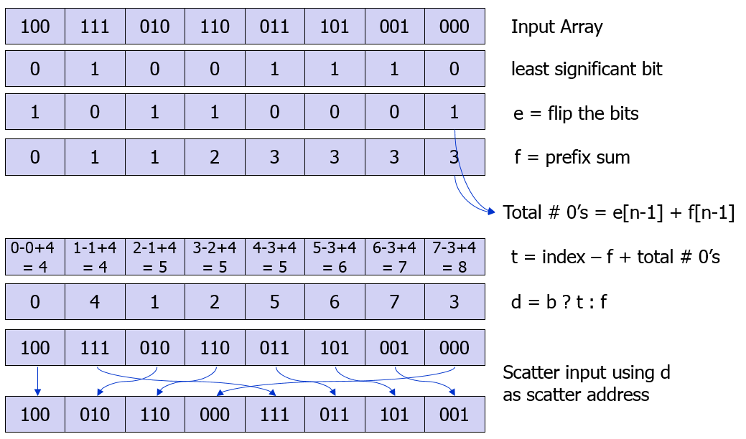
Radix sort and prefix sum
We’ll sort the last digits of a set of binary numbers in a stable way.
Call elements ending in 0 0-vals, the rest1-vals.
Goal is to put the 0-vals before the 1-vals in a stable way.
0-val at index i goes to (# 0-vals before i).
1-val at index i goes to (total # 0-vals) + (# 1-vals before i) = (total # 0-vals) + (i - # 0-vals before i).
Use prefix sum to count # 0-vals up to every index.
http://www.seas.upenn.edu/~cis565/LECTURE2010/CUDALibariesandTools.ppt

Slide 5
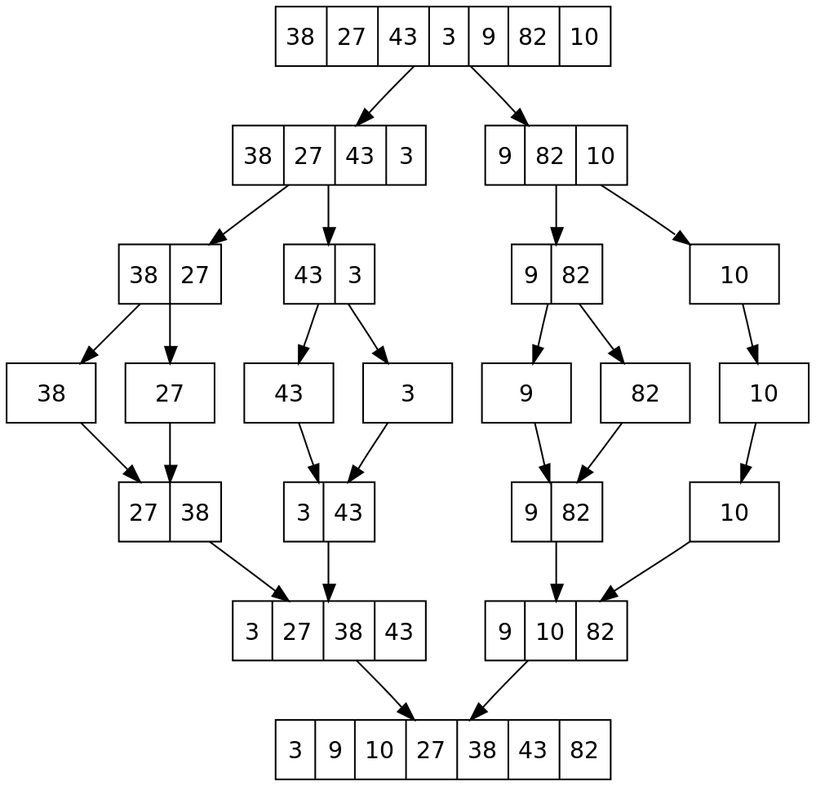
Parallel mergesort
Divide and conquer sort in which subproblems can be solved in parallel.
There are log n divide stages, followed by log n merge stages.
Each merge stage takes O(n) sequential time.
We’ll do each merge stage in O(log n) parallel time with n processors.
So O(log² n) time to sort n numbers with n processors.
Assume for simplicity all values are unique.
https://en.wikipedia.org/wiki/Merge_sort

Slide 6
Parallel merge
A
2 | 8 | 11 | 15
4 | 5 | 7 | 20
B
A | B
2 | 4 | 5 | 7 | 8 | 11 | 15 | 20
rank(x,S) = |{y≤x | y∈S}| = number of values in S less than or equal to x.
Ex rank(8,A)=2, rank(8,B)=3, rank(20,A)=4.
Claim Let x∈A∪B, then rank(x, A | B) = rank(x,A) + rank(x,B).
Ex rank(8, A | B) = 5 = rank(8,A)+rank(8,B) = 2+3.
Ex rank(20, A | B) = 8 = rank(20,A)+rank(20,B) = 4+4.
Proof Say x∈A.
There are rank(x,A) elements ≤ x in A, including x itself, and rank(x,B) elements ≤ x in B, so a total of rank(x,A)+rank(x,B) elements ≤ x in A∪B.

Slide 7
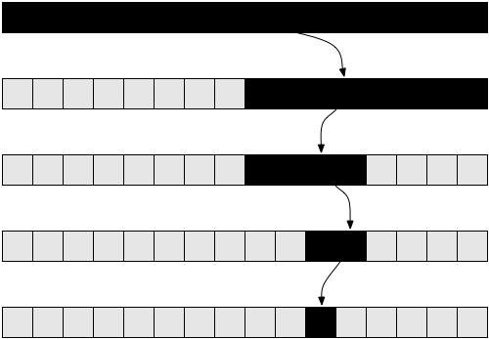
Parallel merge
If S is sorted array of size n, can compute rank(x,S) in O(log n) sequential time.
Do binary search for x in S.
Say search ends at index i. If S[i]=x, return i+1, else return i.
Ex x=11, S=[4,5,7,20], search ends at index 3, so rank(x,S)=3.

Slide 8
Parallel merge
Let A, B be sorted arrays with n elements each.
We compute A | B using 2n processor in O(log n) time.
Output stored in array C of size 2n.
For 1 ≤ i ≤ n, processor i computes r_{i}=rank(A[i],B).
Write A[i] to C(i+r_{i}).
For 1 ≤ j ≤ n, proc j+n computes r_{j}=rank(B[j],A).
Write B[j] to C(j+r_{j}).
rank(A[i],B)
0
3
3
3
1
1
1
4
rank(B[j],A)
A
2 | 8 | 11 | 15
4 | 5 | 7 | 20
B
A | B
2 | 4 | 5 | 7 | 8 | 11 | 15 | 20
index
1
2
3
4
5
6
7
8

Slide 9
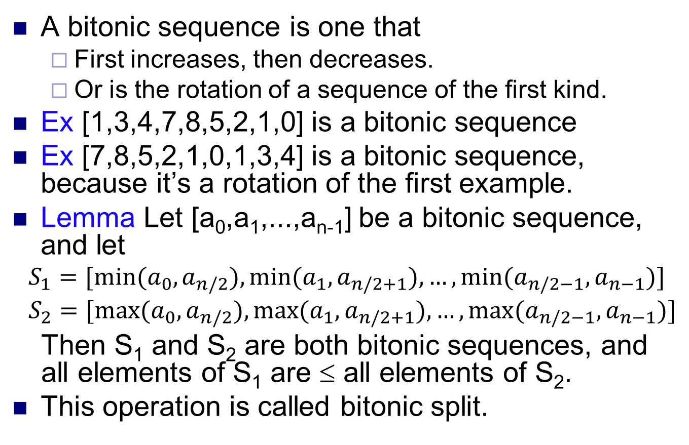
Bitonic sort
A bitonic sequence is one that
First increases, then decreases.
Or is the rotation of a sequence of the first kind.
Ex [1,3,4,7,8,5,2,1,0] is a bitonic sequence
Ex [7,8,5,2,1,0,1,3,4] is a bitonic sequence, because it’s a rotation of the first example.
Lemma Let [a₀,a₁,...,a_{n-1}] be a bitonic sequence, and let
$$S_{1}=[min⁡(a_{0},a_{n/2}),min⁡(a_{1},a_{n/2+1}),…,min⁡(a_{n/2−1},a_{n−1})]$$
$$S_{2}=[max⁡(a_{0},a_{n/2}),max⁡(a_{1},a_{n/2+1}),…,max⁡(a_{n/2−1},a_{n−1})]$$
Then S₁ and S₂ are both bitonic sequences, and all elements of S₁ are ≤ all elements of S₂.
This operation is called bitonic split.

Slide 10
Proof of lemma
S₁
S₂

Slide 11
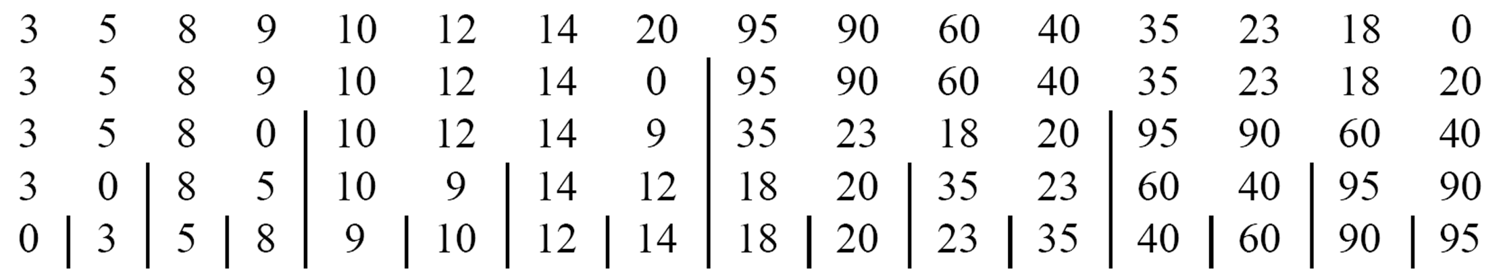
Bitonic merge
Bitonic merge takes a bitonic sequence and converts it to a sorted one using a sequence of bitonic splits.
Given a bitonic sequence S, a bitonic split “sorts” S in the sense that the first half of S is ≤ the second half of S after the split.
Now we can split each half recursively, to sort more finely, into quarters.
Finally, after we split down to sequences of size 1, the entire sequence is sorted in nondecreasing order.

Slide 12
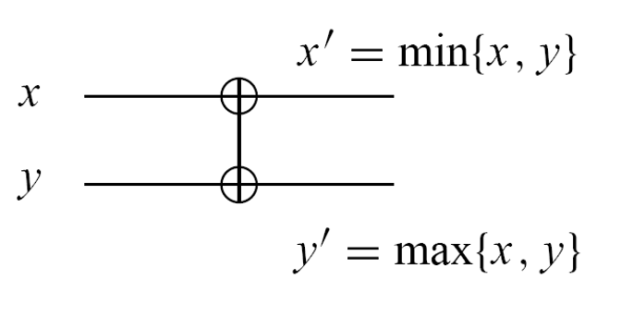
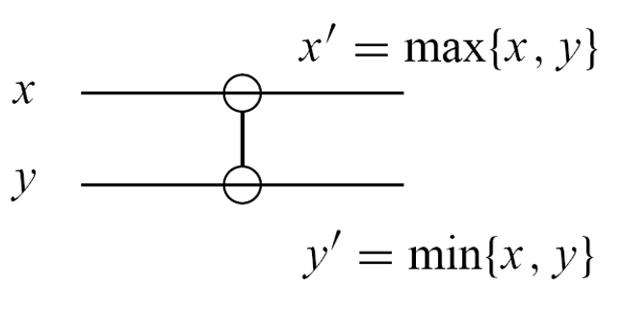
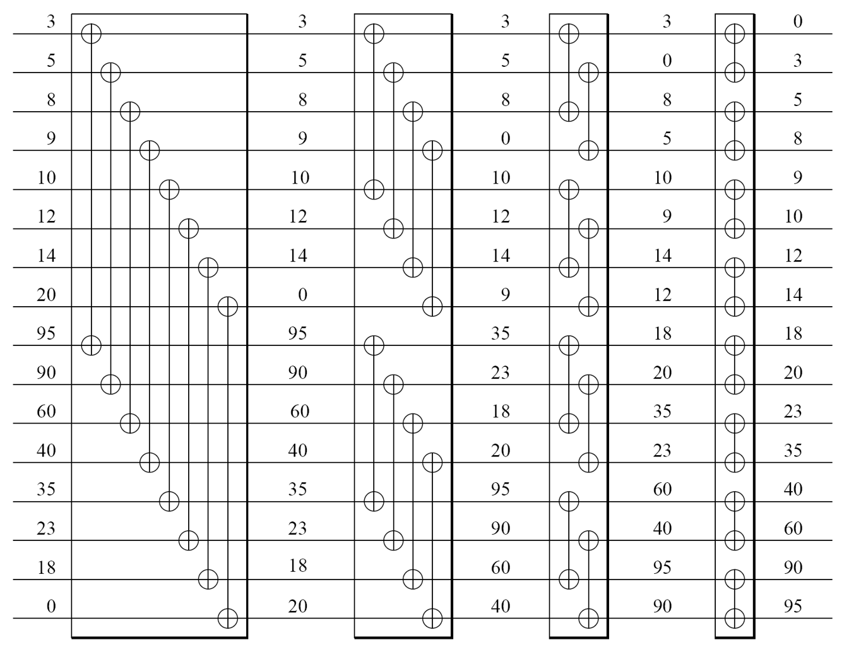
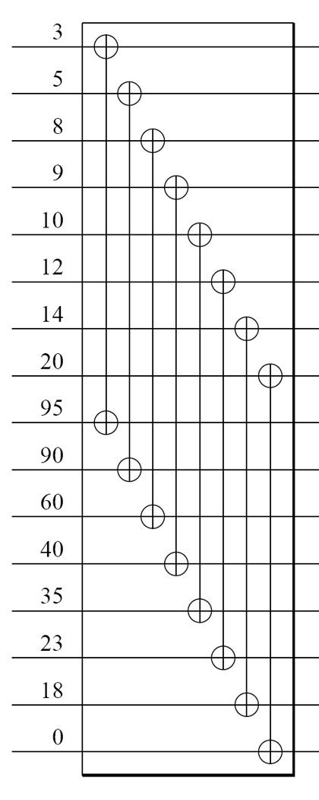
Merging network
The split operation only requires finding max and min of two values. Can do this using a max or min comparator.
Can implement a split in parallel using multiple comparators.
Can implement a merge of a size n bitonic sequence using log n stages of split. So bitonic merge takes O(log n) time.

Slide 13
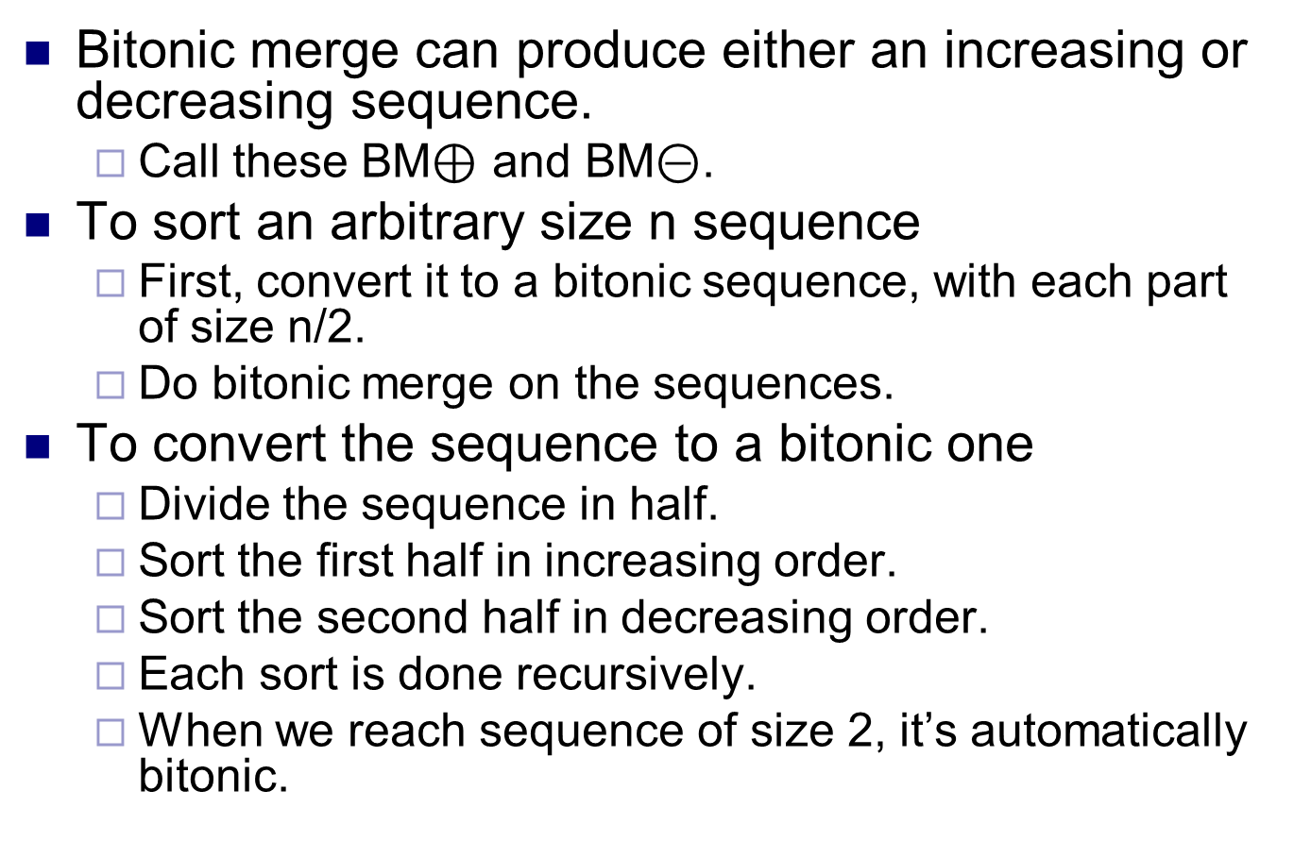
Bitonic sort
Bitonic merge can produce either an increasing or decreasing sequence.
Call these BM$⊕$ and BM$⊝$.
To sort an arbitrary size n sequence
First, convert it to a bitonic sequence, with each part of size n/2.
Do bitonic merge on the sequences.
To convert the sequence to a bitonic one
Divide the sequence in half.
Sort the first half in increasing order.
Sort the second half in decreasing order.
Each sort is done recursively.
When we reach sequence of size 2, it’s automatically bitonic.

Slide 14
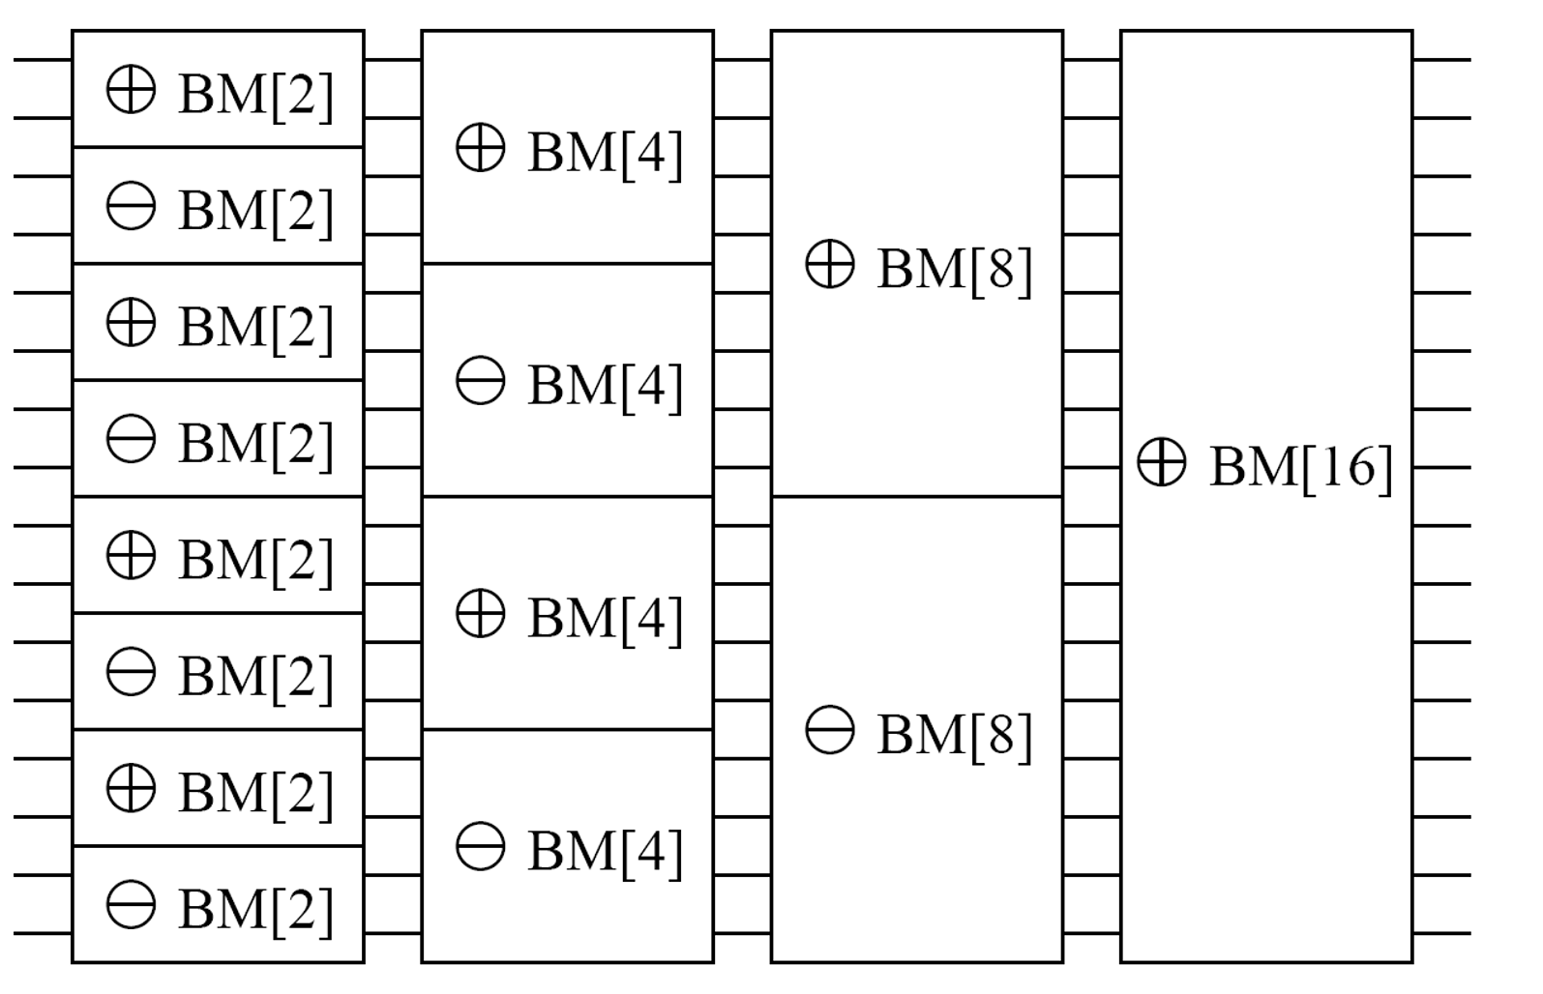
Bitonic sort network
There are log n bitonic merges.
Each bitonic merge takes ≤ log n time.
Bitonic merge takes O(log² n) parallel time total.
Not work efficient, since total work is O(n log² n).
Work efficient sorting networks exist, e.g. the AKS network, but have high constant factors and aren’t practical.

Slide 15
Sample sort
Sample sort is often used in distributed memory setting.
Given p processors to sort n numbers, ideally each processor sorts n/p numbers.
To do this, pick p-1 pivots, say t₁ < t₂ < ... < t_{p-1}. Let t₀ = m and t_{p} = M, where m and M are min and max inputs.
Form p buckets, where i’th bucket contains all inputs between t_{i-1} and t_{i}.
i’th processor sorts i’th bucket sort locally.
If S is the max bucket size, sorting takes O(S log S) parallel time.
Main problem with this approach is buckets are unlikely to be balanced.
For example, if we pick pivots randomly, it’s likely S = Θ(n log n / p), so sorting takes Θ(n log² n / p) instead of the optimal Θ(n log n / p).

Slide 16
Sample sort
Sample sort evens out the bucket sizes, so S = Θ(n / p) with high probability.
Sample r = λp random elements, for λ>1 given later.
Sort the sampled elements and pick every λ’th sample as a pivot, producing p pivots.
Use the pivots to form buckets, as earlier.
Thm If λ=12 ln(n), then no bucket is larger than 4n/p with probability at least 1-1/n².
Proof based on Chernoff bound, which bounds probability a sum of independent random variables deviates substantially from its expectation.
Sample sort runs in Θ(n log n / p) with high probability.
It also has low communication complexity, since it only needs to broadcast the pivots and communicate to form the buckets.

Slide 17
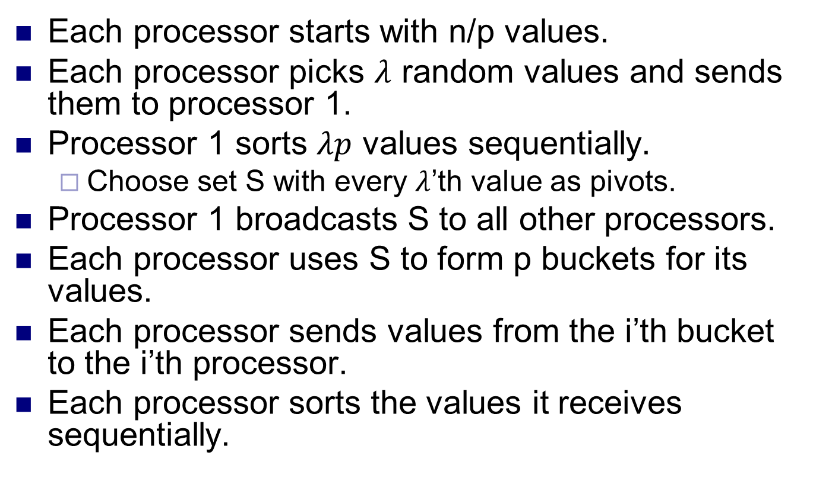
Sample sort algorithm
Each processor starts with n/p values.
Each processor picks $λ$ random values and sends them to processor 1.
Processor 1 sorts $λp$ values sequentially.
Choose set S with every $λ$’th value as pivots.
Processor 1 broadcasts S to all other processors.
Each processor uses S to form p buckets for its values.
Each processor sends values from the i’th bucket to the i’th processor.
Each processor sorts the values it receives sequentially.

Slide 18
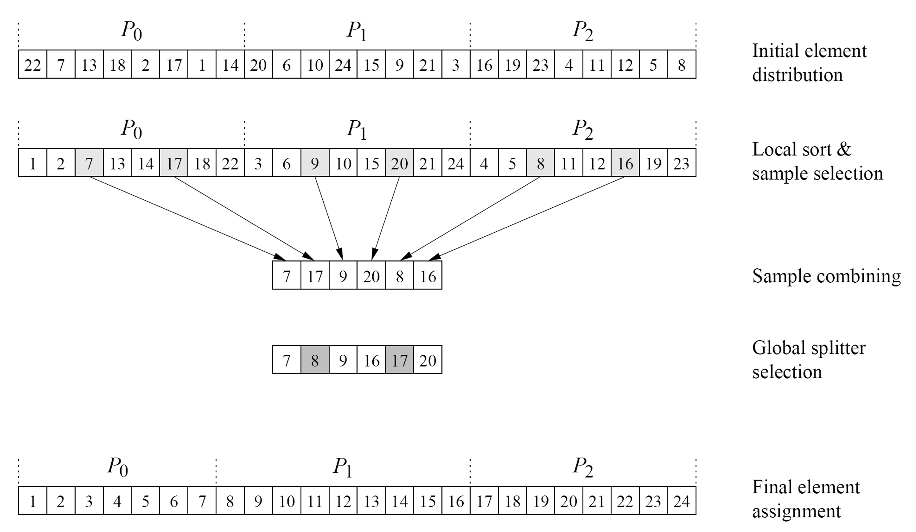
Example

